Slide 1
Chapter 1: Introduction

Slide 2
Chapter 1: Introduction
What is an Operating System?
Computer-System Organization
Operating-System Structure
Operating-System Operations
Process Management
Memory Management
Storage Management
Protection and Security
Kernel Data Structures
Computing Environments
Open-Source Operating Systems
Computer-System Architecture

Slide 3
Objectives
To describe the basic organization of computer systems
To provide a grand tour of the major components of operating systems
To give an overview of the many types of computing environments
To explore several open-source operating systems

Slide 4
What is an Operating System?
A program that acts as an intermediary between a user of a computer and the computer hardware
Operating system goals:
  Execute user programs and make solving user problems easier
  Make the computer system convenient to use
  Use the computer hardware in an efficient manner

Slide 5
Computer System Structure
Computer system can be divided into four components:
  Hardware – provides basic computing resources
    CPU, memory, I/O devices
  Operating system
    Controls and coordinates use of hardware among various applications and users
  Application programs – define the ways in which the system resources are used to solve the computing problems of the users
    Word processors, compilers, web browsers, database systems, video games
  Users
    People, machines, other computers

Slide 6

Four Components of a Computer System

Slide 7
What Operating Systems Do
The operating system controls the hardware and coordinates its use among the various application programs for the various users.
We can also view a computer system as consisting of hardware, software, and data.
The operating system provides the means for proper use of these resources in the operation of the computer system.
An operating system is similar to a government. Like a government, it performs no useful function by itself. It simply provides an environment within which other programs can do useful work.
To understand more fully the operating system's role, we explore operating systems from two viewpoints:
  The user
  The system.

Slide 8
User View
The user's view of the computer varies according to the interface being used
Single user computers (e.g., PC, workstations). Such systems are designed for one user to monopolize its resources. The goal is to maximize the work (or play) that the user is performing. the operating system is designed mostly for ease of use and good performance.
Multi user computers (e.g., mainframes, computing servers). These users share resources and may exchange information. The operating system in such cases is designed to maximize resource utilization -- to assure that all available CPU time, memory, and I/O are used efficiently and that no individual users takes more than their fair share.

Slide 9
User View (Cont.)
Handheld computers (e.g., smartphones and tablets). The user interface for mobile computers generally features a touch screen. The systems are resource poor, optimized for usability and battery life.
Embedded computers (e.g., computers in home devices and automobiles) The user interface may have numeric keypads and may turn indicator lights on or off to show status. The operating systems are designed primarily to run without user intervention.

Slide 10
System View
From the computer's point of view, the operating system is the program most intimately involved with the hardware. There are two different views:
The operating system is a resource allocator
  Manages all resources
  Decides between conflicting requests for efficient and fair resource use
The operating systems is a control program
  Controls execution of programs to prevent errors and improper use of the computer

Slide 11
Defining Operating System
No universally accepted definition of what an OS:
Operating systems exist to offer a reasonable way to solve the problem of creating a usable computing system.
The fundamental goal of computer systems is to execute user programs and to make solving user problems easier.
Since bare hardware alone is not particularly easy to use, application programs are developed.
  These programs require certain common operations, such as those controlling the I/O devices.
  The common functions of controlling and allocating resources are brought together into one piece of software: the operating system.

Slide 12
Defining Operating System (Cont.)
No universally accepted definition of what is part of the OS:
A simple viewpoint is that it includes everything a vendor ships when you order the operating system. The features that are included vary greatly across systems:
  Some systems take up less than a megabyte of space and lack even a full-screen editor,
  Some systems require gigabytes of space and are based entirely on graphical windowing systems.

Slide 13
Defining Operating System (Cont.)
No universally accepted definition of what is part of the OS:
A more common definition, and the one that we usually follow, is that the operating system is the one program running at all times on the computer -- usually called the kernel.
Along with the kernel, there are two other types of programs:
  System programs, which are associated with the operating system but are not necessarily part of the kernel.
  Application programs, which include all programs not associated with the operation of the system.

Slide 14
Defining Operating System (Cont.)
The emergence of mobile devices, have resulted in an increase in the number of features that constituting the operating system.
Mobile operating systems often include not only a core kernel but also middleware -- a set of software frameworks that provide additional services to application developers.
For example, each of the two most prominent mobile operating systems -- Apple's iOS and Google's Android -- feature a core kernel along with middleware that supports databases, multimedia, and graphics (to name only a few).

Slide 15
Evolution of Computer Systems
Users
Applications
Database System
Operating System
Hardware

Slide 16
Computer-System Organization
A modern general-purpose computer system consists of one or more CPUs and a number of device controllers connected through a common bus that provides access to shared memory.
Each device controller is in charge of a specific type of device (for example, disk drives, audio devices, or video displays). Each device controller has a local buffer.
CPU moves data from/to main memory to/from local buffers.
The CPU and the device controllers can execute in parallel, competing for memory cycles. To ensure orderly access to the shared memory, a memory controller synchronizes access to the memory.

Slide 17

Modern Computer System

Slide 18
Computer Startup
Bootstrap program is loaded at power-up or reboot
  Typically stored in ROM or EPROM, generally known as firmware
  Initializes all aspects of system
  Loads operating system kernel and starts execution

Slide 19
Computer-System Operation
Once the kernel is loaded and executing, it can start providing services to the system and its users.
Some services are provided outside of the kernel, by system programs that are loaded into memory at boot time to become system processes, or system daemons that run the entire time the kernel is running.
On UNIX, the first system process is init and it starts many other daemons. Once this phase is complete, the system is fully booted, and the system waits for some event to occur.
The occurrence of an event is usually signaled by an interrupt.

Slide 20
Interrupts
There are two types of interrupts:
  Hardware -- a device may trigger an interrupt by sending a signal to the CPU, usually by way of the system bus.
  Software -- a program may trigger an interrupt by executing a special operation called a system call.
A software-generated interrupt (sometimes called trap or exception) is caused either by an error (e.g., divide by zero) or a user request (e.g., an I/O request).
An operating system is interrupt driven.

Slide 21
Common Functions of Interrupts
When an interrupt occurs, the operating system preserves the state of the CPU by storing the registers and the program counter
Determines which type of interrupt has occurred and transfers control to the interrupt-service routine.
An interrupt-service routine is a collection of routines (modules), each of which is responsible for handling one particular interrupt (e.g., from a printer, from a disk)
The transfer is generally through the interrupt vector, which contains the addresses of all the service routines
Interrupt architecture must save the address of the interrupted instruction.

Slide 22
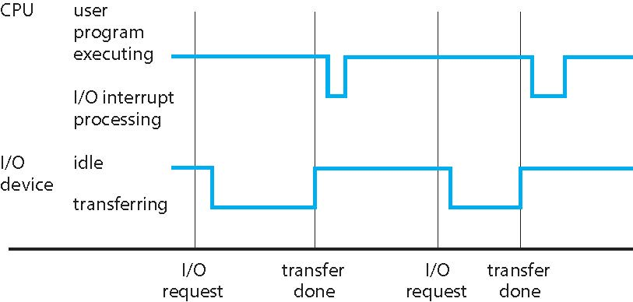
Interrupt Timeline

Slide 23
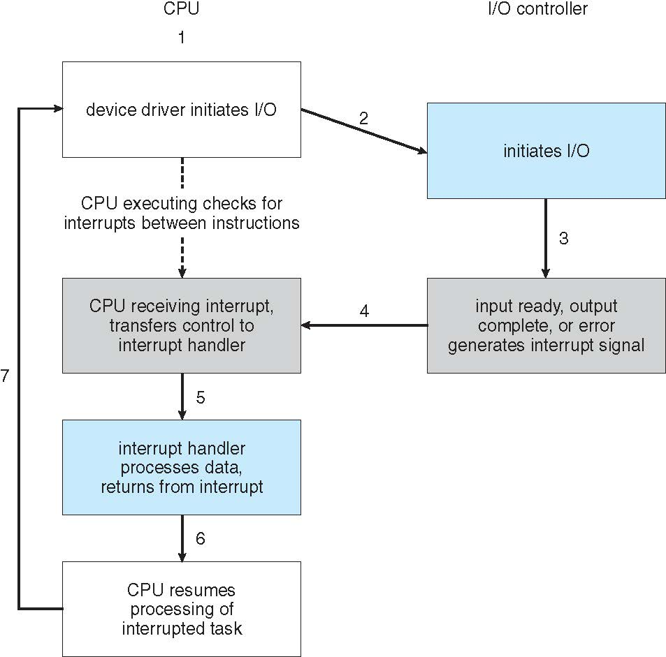
Interrupt-driven I/O cycle.

Slide 24
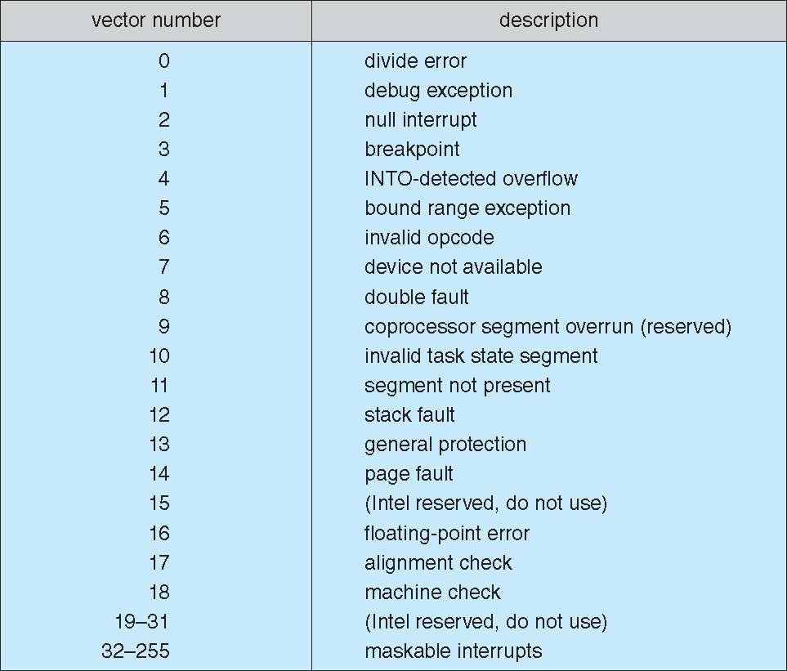
Intel Pentium processor event-vector table

Slide 25
Storage Structure
Main memory – the only large storage media that the CPU can access directly
  Random access
  Typically volatile
Secondary storage – extension of main memory that provides large nonvolatile storage capacity
  Hard disks – rigid metal or glass platters covered with magnetic recording material
    Disk surface is logically divided into tracks, which are subdivided into sectors
    The disk controller determines the logical interaction between the device and the computer
  Solid-state disks – faster than hard disks, nonvolatile
    Various technologies
    Becoming more popular
Tertiary storage

Slide 26
Storage Definition
The basic unit of computer storage is the bit. A bit can contain one of two values, 0 and 1. All other storage in a computer is based on collections of bits.
A byte is 8 bits, and on most computers it is the smallest convenient chunk of storage.
A less common term is word, which is a given computer architecture’s native unit of data. A word is made up of one or more bytes.

Slide 27
Storage Definition (Cont.)
Computer storage, along with most computer throughput, is generally measured and manipulated in bytes and collections of bytes.
  A kilobyte, or KB, is 1,024 bytes
  a megabyte, or MB, is 1,024² bytes
  a gigabyte, or GB, is 1,024³ bytes
  a terabyte, or TB, is 1,024⁴ bytes
  a petabyte, or PB, is 1,024⁵ bytes
  exabyte, zettabyte, yottabyte
Computer manufacturers often round off these numbers and say that a megabyte is 1 million bytes and a gigabyte is 1 billion bytes. Networking measurements are an exception to this general rule; they are given in bits (because networks move data a bit at a time).

Slide 28
Storage Hierarchy
Storage systems organized in hierarchy
  Speed
  Cost
  Volatility
Caching – copying information from “slow” storage into faster storage system;
  Main memory can be viewed as a cache for secondary storage
Device Driver for each device controller to manage I/O
  Provides uniform interface between controller and kernel

Slide 29
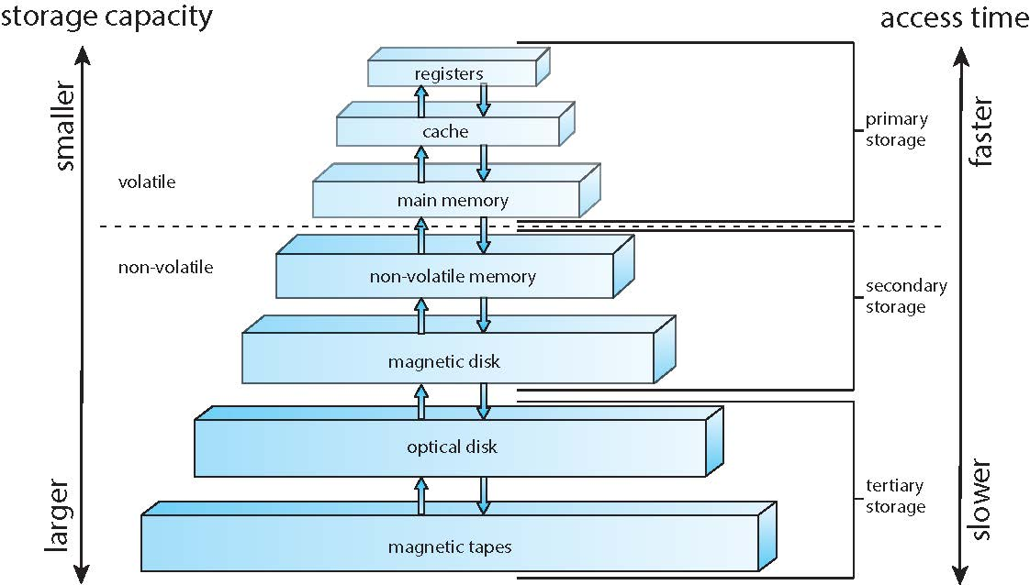
Storage-device hierarchy

Slide 30
I/O Structure
A general-purpose computer system consists of CPUs and multiple device controllers that are connected through a common bus.
Each device controller is in charge of a specific type of device. More than one device may be attached. For instance, seven or more devices can be attached to the small computer-systems interface (SCSI) controller.
A device controller maintains some local buffer storage and a set of special-purpose registers.
The device controller is responsible for moving the data between the peripheral devices that it controls and its local buffer storage.
Typically, operating systems have a device driver for each device controller. This device driver understands the device controller and provides the rest of the operating system with a uniform interface to the device.

Slide 31
I/O Structure (Cont.)
To start an I/O operation, the device driver loads the appropriate registers within the device controller.
The device controller, in turn, examines the contents of these registers to determine what action to take (such as “read” a character from the keyboard).
The controller starts the transfer of data from the device to its local buffer. Once the transfer of data is complete, the device controller informs the device driver via an interrupt that it has finished its operation.
The device driver then returns control to the operating system, possibly returning the data or a pointer to the data if the operation was a read.
For other operations, the device driver returns status information.

Slide 32
Direct Memory Access Structure
Interrupt-driven I/O is fine for moving small amounts of data but can produce high overhead when used for bulk data movement such as disk I/O.
To solve this problem, direct memory access (DMA) is used.
  After setting up buffers, pointers, and counters for the I/O device, the device controller transfers an entire block of data directly to or from its own buffer storage to memory, with no intervention by the CPU.
  Only one interrupt is generated per block, to tell the device driver that the operation has completed. While the device controller s performing these operations, the CPU is available to accomplish other work.
Some high-end systems use switch rather than bus architecture. On these systems, multiple components can talk to other components concurrently, rather than competing for cycles on a shared bus. In this case, DMA is even more effective. The figure in next slide shows the interplay of all components of a computer system.

Slide 33

How a Modern Computer Works
A von Neumann architecture and a depiction of the interplay of all components of a computer system.

Slide 34
Overview and History
Operating System driven by Cost of resources
Much of operating system history driven by relative cost factors of hardware and people. In the beginning:
  Expensive Hardware, Cheap People ( Phase I )
    Goal: maximize hardware utilization.
  Now: Cheap Hardware, Expensive People ( Phase II )
    Goal: make it easy for people to use computer.
Relative costs drive the goals of the operating system.

Slide 35
Phase – I, Hardware is costly
Computers in earlier days of their inception were very bulky, large machines usually run from a console.
I/O devices consisted of card readers, tape drives and line printers.
Direct user interaction with the system did not exist.
Users made a job consisting of programs, data and control information. The job was submitted to an operator who would execute the job on the computer system from the front panel switches(one instruction at a time) from a paper tape or punched cards. Then appropriate buttons would be pushed to set the starting address and to start the execution of the program. The output appeared after minutes, hours or sometimes days. O/P was printed or was punched onto cards or paper tape for later printing. The user collected the output from the operator, which also included a memory dump.
The operating system was very simple and its major task was to transfer control from one job to another. The operating system was resident in memory

Slide 36
Computer-System Architecture
Single general-purpose processor
  CPU (for executing all instructions) + special-purpose processors like device specific disk, I/O controllers with limited instruction set
To speed up processing - jobs with the same needs were batched together and executed as a group - batch operating systems.
But still the CPU was often idle
  disparity between operating speeds of electronic devices like the CPU and the mechanical I/O devices. CPU operates in the microsecond / nanosecond ranges whereas I/O devices work in the second / minute range.
  With improvements in technology, I/O devices became faster but CPU speeds became even faster. So the problem of disparity in operating speeds only widened.
Operating system
User area
Figure 2.1: Memory layout for simple batch system
Notes:
N processes can run if there are N CPUs—without causing performance to deteriorate significantly.
Also, since the CPUs are separate, one may be sitting
idle while another is overloaded, resulting in inefficiencies. These inefficiencies
can be avoided if the processors share certain data structures.Amultiprocessor
system of this form will allow processes and resources—such as memory—
to be shared dynamically among the various processors and can lower the
variance among the processors.

Slide 37
Maximizing machine utilization - Spooling
  Solution: Store jobs on a disk (spooling), have computer read them in one at a time and execute them. Build a batch monitor. Big change in computer usage: debugging now done offline from print outs and memory dumps. No more instant feedback.
The introduction of disks brought in the concept of spooling - Instead of reading from slow input devices like card readers into the computer memory and then processing the job, the input is first read into the disk.
When the job is processed or executed, the input is read directly from the disk. Similarly when a job is executed for printing, the output is written into a buffer on the disk and actually printed later.
This form of processing is known as spooling an acronym for Simultaneous Peripheral Operation On Line.
Spooling overlaps I/O of one job with the computation of other jobs. For example, spooler may be reading the input of one job while printing the output of another and executing a third job increases the performance of the system by allowing both a faster CPU and slower I/O devices to work at higher operating rates

Slide 38
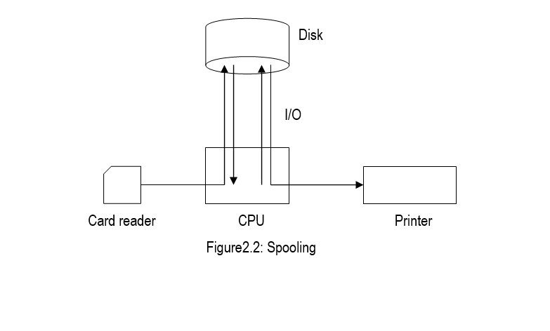

Slide 39
Mainframe Systems
Reduce setup time by batching similar jobs
Automatic job sequencing – automatically transfers control from one job to another. First rudimentary operating system.
Resident monitor
  initial control in monitor
  control transfers to job
  when job completes control transfers back to monitor

Slide 40
Utilization of CPU & I/O
Problem: one job can't keep both CPU and I/O devices busy. Get poor utilization either of CPU or I/O devices.
Solution: multiprogramming - several jobs share system. Dynamically switch from one job to another when the running job does I/O.
Big issue: protection. Don't want one job to affect the results of another. Memory protection and relocation added to hardware, OS must manage new hardware functionality. OS starts to become a significant software system.

Slide 41

Multiprogrammed Batch Systems
Several jobs are kept in main memory at the same time, and the
CPU is multiplexed among them.

Slide 42
Multiprogrammed System
Multiprogramming organizes jobs (code and data) so CPU always has one to execute
A subset of total jobs in system is kept in memory
Batch systems:
  One job selected and run via job scheduling
  When it has to wait (for I/O for example), OS switches to another job
Interactive systems:
  Logical extension of batch systems -- CPU switches jobs so frequently that users can interact with each job while it is running, creating interactive computing

Slide 43
Interactive Systems
Response time should be < 1 second
Each user has at least one program executing in memory. Such a program is referred to as a process
If several processes are ready to run at the same time, we need to have CPU scheduling.
If processes do not fit in memory, swapping moves them in and out to run
Virtual memory allows execution of processes not completely in memory

Slide 44
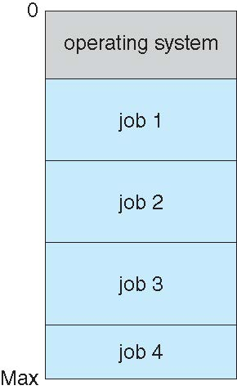
Memory Layout for Multiprogrammed System

Slide 45
Computer-System Architecture
Multiprocessors systems
  Also known as parallel systems, tightly-coupled systems
  Share computer bus, timer and peripherals
  Started with servers but also in laptop/desktops and smart phones also.
  Advantages include:
    Increased throughput – The speed up ratio is not N due to overhead of perfect communication/cooperation + contention for shared resources lowers the expected gain
    Economy of scale – Multiple processors working on certain data has lesser cost due to sharing of peripherals, mass storage
    Increased reliability – failure does not halt the system. Graceful-degradation/fault-tolerance
  Two types:
    Symmetric Multiprocessing – each processor are peers having all their own resources – register, cache and performs all tasks AIX - commercial Unix IBM machine. N CPU => N processes
    Asymmetric Multiprocessing – each processor is assigned a specific task by the Boss processor.
Notes:
N processes can run if there are N CPUs—without causing performance to deteriorate significantly.
Also, since the CPUs are separate, one may be sitting
idle while another is overloaded, resulting in inefficiencies. These inefficiencies
can be avoided if the processors share certain data structures.Amultiprocessor
system of this form will allow processes and resources—such as memory—
to be shared dynamically among the various processors and can lower the
variance among the processors.

Slide 46
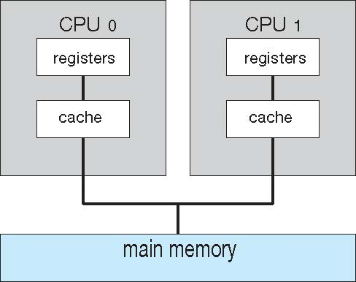
Symmetric Multiprocessing Architecture
CPU has an integrated memory controller => adding CPUs increase the amount of memory addressable causing a system to change its memory access model from uniform memory access (UMA) to non-uniform memory access (NUMA).
UMA when access to any RAM from any CPU takes the same amount of time.
With NUMA, some parts of memory may take longer to access than other parts, creating a performance penalty.
NUMA penalty is minimized by resource management

Slide 47
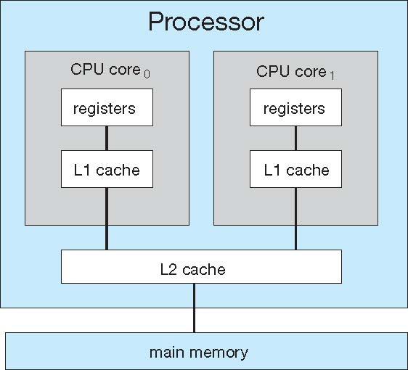
Multicore Systems
Most CPU design now includes multiple computing cores on a single chip. Such multiprocessor systems are termed multicore.
Multicore systems can be more efficient than multiple chips with single cores because:
  On-chip communication is faster than between-chip communication.
  One chip with multiple cores uses significantly less power than multiple single-core chips, an important issue for laptops as well as mobile devices.
Note -- while multicore systems are multiprocessor systems, not all multiprocessor systems are multicore.

Slide 48
Blade Servers
Finally, blade servers - multiple processor boards, I/O boards, and networking boards are placed in the same chassis.
Difference between these and traditional multiprocessor systems
Each blade-processor board boots independently and runs its own
operating system.
Some blade-server boards are multiprocessor as well, which blurs the lines between types of computers.
In essence, these servers consist of multiple independent multiprocessor systems

Slide 49
Clustered Systems
Like multiprocessor systems, but multiple systems working together – composed of two or more individual systems/nodes joined together – loosely coupled. Each node being a single processor system or a multicore system.
Clustered computers share storage and are closely linked via a local-area network LAN or a faster interconnect, such as InfiniBand.
Usually sharing storage via a storage-area network (SAN)
Provides a high-availability of services by adding a level of redundancy which even survives failures
  Asymmetric clustering has one machine in hot-standby mode
  Symmetric clustering has multiple nodes running applications, monitoring each other using all possible hardware.
Some clusters are for high-performance computing (HPC) providing greater computational power
  Applications must be written to use parallelization
Parallel Clusters allows multiple hosts to access the same data on shared storage + require the use of special versions of software and special releases of applications.
  Access control and locking system to avoid conflicting accesses.
Clusters over WAN
Some have distributed lock manager (DLM) to avoid conflicting operations

Slide 50

Clustered Systems

Slide 51
Computing Environments – Real-Time Systems
Real-time embedded systems most prevalent form of computers
  Vary considerable, special purpose, limited purpose OS, real-time OS
  Use expanding
Many other special computing environments as well
  Some have OSes, some perform tasks without an OS
Real-time OS has well-defined fixed time constraints
  Processing must be done within constraint
  Correct operation only if constraints met

Slide 52
Modes of Operation
A mechanism that allows the OS to protect itself and other system components
Two modes:
  User mode
  Kernel mode
Mode bit (0 or 1) provided by hardware
  Provides ability to distinguish when system is running user code or kernel code
  Some instructions designated as privileged, only executable in kernel mode
  Systems call by a user asking the OS to perform some function changes from user mode to kernel mode.
  Return from a system call resets the mode to user mode.

Slide 53

Transition from User to Kernel Mode

Slide 54
Timer
To prevent process to be in infinite loop (process hogging resources), a timer is used, which is a hardware device.
Timer is a counter that is decremented by the physical clock.
Timer is set to interrupt the computer after some time period
Operating system sets the counter (privileged instruction)
When counter reaches the value zero, and interrupt is generated.
The OS sets up the value of the counter before scheduling a process to regain control or terminate program that exceeds allotted time

Slide 55
End of Chapter 1

Slide 56
Process Management
A process is a program in execution. It is a unit of work within the system. Program is a passive entity, process is an active entity.
Process needs resources to accomplish its task
  CPU, memory, I/O, files, etc.
  Initialization data
Process termination requires reclaim of any reusable resources
A thread is a basic unit of CPU utilization within a process.
  Single-threaded process. Instructions are executed sequentially, one at a time, until completion
  Process has one program counter specifying location of next instruction to execute
Multi-threaded process has one program counter per thread
Typically, a system has many processes, some user, some operating system running concurrently on one or more CPUs
  Concurrency by multiplexing the CPUs among the threads

Slide 57
Process Management Activities
The operating system is responsible for the following activities in connection with process management:
Creating and deleting both user and system processes
Suspending and resuming processes
Providing mechanisms for process synchronization
Providing mechanisms for process communication
Providing mechanisms for deadlock handling

Slide 58
Memory Management
To execute a program all (or part) of the instructions must be in memory
All (or part) of the data that is needed by the program must be in memory.
Memory management determines what is in memory and when
  Optimizing CPU utilization and computer response to users
Memory management activities
  Keeping track of which parts of memory are currently being used and by whom
  Deciding which processes (or parts thereof) and data to move into and out of memory
  Allocating and deallocating memory space as needed

Slide 59
Storage Management
OS provides uniform, logical view of information storage
Abstracts physical properties to logical storage unit - file
Files are stored in a number of different storage medium.
  Disk
  Flash Memory
  Tape
Each medium is controlled by device drivers (i.e., disk drive, tape drive)
  Varying properties include access speed, capacity, data-transfer rate, access method (sequential or random)

Slide 60
File System Management
Files usually organized into directories
Access control on most systems to determine who can access what
OS activities include
  Creating and deleting files and directories
  Primitives to manipulate files and directories
  Mapping files onto secondary storage
  Backup files onto stable (non-volatile) storage media

Slide 61
Secondary-Storage Management
Usually disks used to store data that does not fit in main memory or data that must be kept for a “long” period of time
Proper management is of central importance
Entire speed of computer operation hinges on disk subsystem and its algorithms
OS activities
  Free-space management
  Storage allocation
  Disk scheduling
Some storage need not be fast
  Tertiary storage includes optical storage, magnetic tape
  Still must be managed – by OS or applications

Slide 62
Caching
Important principle, performed at many levels in a computer (in hardware, operating system, software)
Information in use copied from slower to faster storage temporarily
Faster storage (cache) checked first to determine if information is there
  If it is, information used directly from the cache (fast)
  If not, data copied to cache and used there
Cache are smaller (size-wise) than storage being cached
  Cache management important design problem
  Cache size and replacement policy

Slide 63

Performance of Various Levels of Storage
Movement between levels of storage hierarchy can be explicit or implicit

Slide 64

Migration of data “A” from Disk to Register
Multitasking environments must be careful to use most recent value, no matter where it is stored in the storage hierarchy
Multiprocessor environment must provide cache coherency in hardware such that all CPUs have the most recent value in their cache
Distributed environment situation even more complex
  Several copies of a datum can exist
  Various solutions covered in Chapter 17

Slide 65
I/O Subsystem
One purpose of an operating system is to hide peculiarities of hardware devices from the user
I/O subsystem responsible for
  Memory management of I/O including buffering (storing data temporarily while it is being transferred), caching (storing parts of data in faster storage for performance), spooling (the overlapping of output of one job with input of other jobs)
  General device-driver interface
  Drivers for specific hardware devices

Slide 66
Protection and Security
Protection – A mechanism for controlling access of processes (or users) to resources defined by the OS
Security – A defense of the system against internal and external attacks
  Huge range, including denial-of-service, worms, viruses, identity theft, theft of service
Systems generally first distinguish among users, to determine who can do what
  User identities (user IDs, security IDs) include name and associated number, one per user
  User ID is associated with all files and processes of that user to determine access control
  Group identifier (group ID) allows set of users to be defined and controls managed, then also associated with each process, file
  Privilege escalation allows user to change to effective ID with more rights

Slide 67
Virtualization
Allows operating systems to run applications within other OSes
  Vast and growing industry
Emulation used when the source CPU type is different from the target type (i.e., PowerPC to Intel x86)
  Generally slowest method
  When computer language not compiled to native code – Interpretation
Virtualization – OS natively compiled for CPU, running guest OSes also natively compiled
  Consider VMware running WinXP guests, each running applications, all on native WinXP host OS
  VMM (virtual machine Manager) provides virtualization services

Slide 68
Virtualization on Laptops and Destops
A VMM allow the user to install multiple operating systems to run application written for operating systems other than the native host.
  Apple laptop running Mac OS X host Windows as a guest
  Developing apps for multiple OSes without having multiple systems
  Testing applications without having multiple systems
  Executing and managing compute environments within data centers

Slide 69

Virtualization Architecture Structure

Slide 70



Kernel Data Structures
Many -- similar to standard programming data structures
Singly linked list
Doubly linked list
Circular linked list

Slide 71
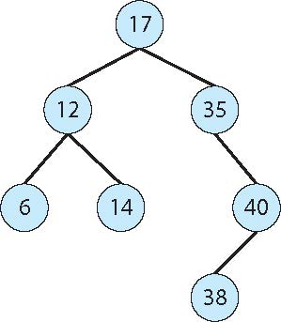
Binary search tree

Slide 72

Kernel Data Structures
Hash function can create a hash map
Bitmap – string of n binary digits representing the status of n items
Linux data structures defined in
include files <linux/list.h>, <linux/kfifo.h>, <linux/rbtree.h>

Slide 73
Computing Environments - Traditional
Stand-alone general purpose machines
But blurred as most systems interconnect with others (i.e., the Internet)
Portals provide web access to internal systems
Network computers (thin clients) are like Web terminals
Mobile computers interconnect via wireless networks
Networking becoming ubiquitous – even home systems use firewalls to protect home computers from Internet attacks

Slide 74
Computing Environments - Mobile
Handheld smartphones, tablets, etc
What is the functional difference between them and a “traditional” laptop?
Extra features – more OS features (GPS -- Waze)
Allows new types of apps like augmented reality
Use IEEE 802.11 wireless, or cellular data networks for connectivity
Leaders are Apple iOS and Google Android

Slide 75
Computing Environments – Distributed
Collection of separate, possibly heterogeneous, systems networked together
  Network is a communications path, TCP/IP most common
    Local Area Network (LAN)
    Wide Area Network (WAN)
    Metropolitan Area Network (MAN)
    Personal Area Network (PAN)
Network Operating System provides features to allow sharing of data between systems across a network.
  Communication scheme allows systems to exchange messages
  Illusion of a single system

Slide 76

Computing Environments – Client-Server
Dumb terminals supplanted by smart PCs
Many systems now servers, responding to requests generated by clients
  Compute-server system provides an interface to client to request services (i.e., database)
  File-server system provides interface for clients to store and retrieve files

Slide 77

Computing Environments - Peer-to-Peer
Another model of distributed system. P2P does not distinguish clients and servers
  Instead all nodes are considered peers
  Each node may act as client, server, or both
  Node must join P2P network
    Registers its service with central lookup service on network, or
    Broadcast request for service and respond to requests for service via discovery protocol
  Examples include Napster and Gnutella, Voice over IP (VoIP) such as Skype

Slide 78
Computing Environments – Cloud Computing
Delivers computing, storage, even apps as a service across a network
Logical extension of virtualization because it uses virtualization as the base for it functionality.
  Amazon EC2 has thousands of servers, millions of virtual machines, petabytes of storage available across the Internet, pay based on usage
Many types
  Public cloud – available via Internet to anyone willing to pay
  Private cloud – run by a company for the company’s own use
  Hybrid cloud – includes both public and private cloud components
  Software as a Service (SaaS) – one or more applications available via the Internet (i.e., word processor)
  Platform as a Service (PaaS) – software stack ready for application use via the Internet (i.e., a database server)
  Infrastructure as a Service (IaaS) – servers or storage available over Internet (i.e., storage available for backup use)

Slide 79

Computing Environments – Cloud Computing
Cloud computing environments composed of traditional OSes, plus VMMs, plus cloud management tools
  Internet connectivity requires security like firewalls
  Load balancers spread traffic across multiple applications

Slide 80
Computing Environments – Real-Time Systems
Real-time embedded systems most prevalent form of computers
  Vary considerable, special purpose, limited purpose OS, real-time OS
  Use expanding
Many other special computing environments as well
  Some have OSes, some perform tasks without an OS
Real-time OS has well-defined fixed time constraints
  Processing must be done within constraint
  Correct operation only if constraints met

Slide 81
Open-Source Operating Systems
Operating systems made available in source-code format rather than just binary closed-source
Counter to the copy protection and Digital Rights Management (DRM) movement
Started by Free Software Foundation (FSF), which has “copyleft” GNU Public License (GPL)
Examples include GNU/Linux and BSD UNIX (including core of Mac OS X), and many more
Can use VMM like VMware Player (Free on Windows), Virtualbox (open source and free on many platforms - http://www.virtualbox.com)
  Use to run guest operating systems for exploration

Slide 82
End of Chapter 1

